Slide 1


Leonardo A. M. Pessôa
12-03-2023

Slide 2

Outline
Executive Summary
Introduction
Methodology
Results
Conclusion
Appendix

Slide 3
Executive Summary
Summary of methodologies
Data Analysis Methodology
KNN
Decision Tree
Support Vector Machine
Logistic Regression
Summary of all results
Data from Space X
Increase rate of success
Prediction model created – high probability to forecast success outcome (83%)

Slide 4
Introduction
Project background and context
SPACE Y – why Y is better – because we know the X path
Forecast about SPACE X launches and possible stage 1 reuse
Competitive information about price
Problems you want to find answers
Data – where collect?
Data – Exploratory – Analysis – Forecast
How the success rate changes along the time
What are best models to evaluate the outcome

Slide 5

Section 1

Slide 6
Methodology
Executive Summary
Data collection methodology:
Data collect from SPACEX REST API
Perform data wrangling
Data cleaning, NaN observations and normalization
Perform exploratory data analysis (EDA) using visualization and SQL
Perform interactive visual analytics using Folium and Plotly Dash
Perform predictive analysis using classification models
How to build, tune, evaluate classification models

Slide 7
Data Collection
Request to the SpaceX API
Normalize
DataFrame
NaN

Slide 8
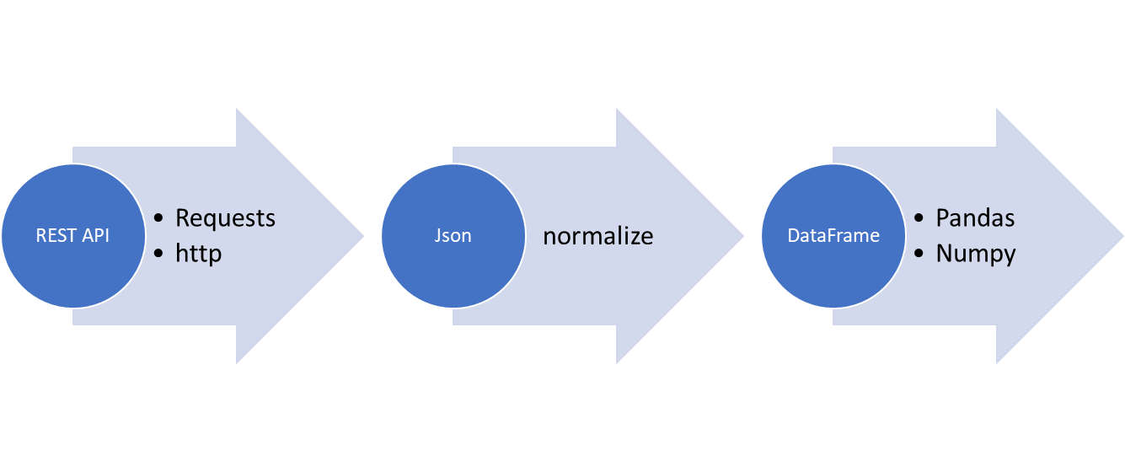
Data Collection – SpaceX API
Flowchart
The following link details the process:
https://github.com/lampessoa/IBM_course/blob/947d954e8fc79c061ad50ebf793ffa54a5084479/Projeto%20Final%20-%20Dados%20(1).ipynb
Place your flowchart of SpaceX API calls here

Slide 9
Data Collection - Scraping
Request
HTML
BeautifulSoup
SOUP
Parsing
DATA FRAME
Web scraping Falcon 9 and Falcon Heavy Launches Records from Wikipedia
https://github.com/lampessoa/IBM_course/blob/1c07e418aa0dcddbaff24a46941b24688250f8f6/Projeto%20Final%20-%20webscraping.ipynb

Slide 10
Data Wrangling
Data Analysis
drop
Orbit and Outcome
Launchs per site
Outcome
Landing Outcomes
Verifying data Nan
https://github.com/lampessoa/IBM_course/blob/ac3a586fe2430d1952e18c1aafe2782672af46b4/Projeto%20Final%20-%20Data%20Wrangling%20(1).ipynb

Slide 11
EDA with Data Visualization
FlightNumber vs. PayloadMass/class – (pay load influentiates the outcome?)
FlightNumber vs LaunchSite/class –lauch site influentiates the outcome?
Payload and Launch Site/class – relation of payload and launchsite
Success rate of each orbit type – the orbit influentiates the outcome?
FlightNumber and Orbit type
Payload and Orbit type – relation
launch success yearly trend
https://github.com/lampessoa/IBM_course/blob/d2b379d1a74c0d6771d005f1bcb20c713492c2a0/Projeto%20Final%20-%20EDA.ipynb

Slide 12
EDA with SQL
SQL queries performed
names of the unique launch sites in the space mission
records where launch sites begin with the string 'CCA’
total payload mass carried by boosters launched by NASA (CRS)
average payload mass carried by booster version F9 v1.1
date when the first successful landing outcome in ground pad was acheived.
boosters which have success in drone ship and have payload mass greater than 4000 but less than 6000
total number of successful and failure mission outcomes
successful landing outcomes between the date 04-06-2010 and 20-03-2017
https://github.com/lampessoa/IBM_course/blob/d90b8780e03b51b3f564805f9baf024829411d67/jupyter_labs_eda_sql_coursera_sqllite.ipynb

Slide 13
Build an Interactive Map with Folium
Added Markers representing the launch sites and the failures/successes
Geographical representation, proximity to coastlines, roads and buidings
This item was not totally completed (distances)
https://github.com/lampessoa/IBM_course/blob/ad51d40632a27df5bebc181eb589b9f3acabf80f/IBM-DS0321EN-SkillsNetwork_labs_module_3_lab_jupyter_launch_site_location.jupyterlite%20(2).ipynb

Slide 14
Build a Dashboard with Plotly Dash
Successes/Insucesses for each launch site
Scatter Plot Payload X launch Site (success/insuccess)
Evaluate geographic differences on success rate
Payload influence
https://github.com/lampessoa/IBM_course/blob/c506a2a469e972c10d5d499e79172e860f7e17fa/DashSpaceX%20(1).ipynb

Slide 15
Predictive Analysis (Classification)
Standartize data
Split data
Logistic Regression
SVM
Decision Tree
KNN
Train - Parameters – Grid Search
Accuracy of each model
Test on data not used for training
Contingency tables
https://github.com/lampessoa/IBM_course/blob/b51fabfe4850627a71ff83522c85b66baf466e16/IBM-DS0321EN-SkillsNetwork_labs_module_4_SpaceX_Machine_Learning_Prediction_Part_5.jupyterlite%20(1).ipynb

Slide 16
Results
Exploratory data analysis results
Interactive analytics demo in screenshots
Predictive analysis results

Slide 17

Section 2

Slide 18
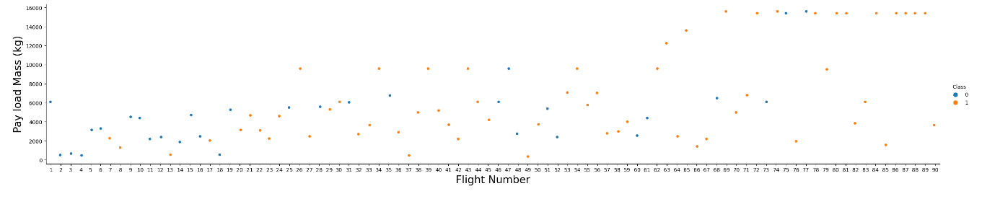
Flight Number vs. Launch Site
flight number increases, the first stage is more likely to land successfully.
more massive the payload, the less likely the first stage will return

Slide 19
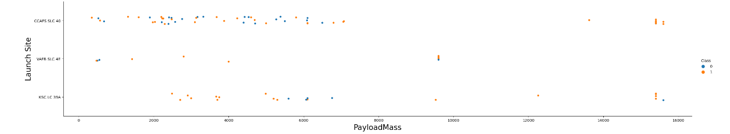
Payload vs. Launch Site
Preponderance of CCAFS SLC 40

Slide 20
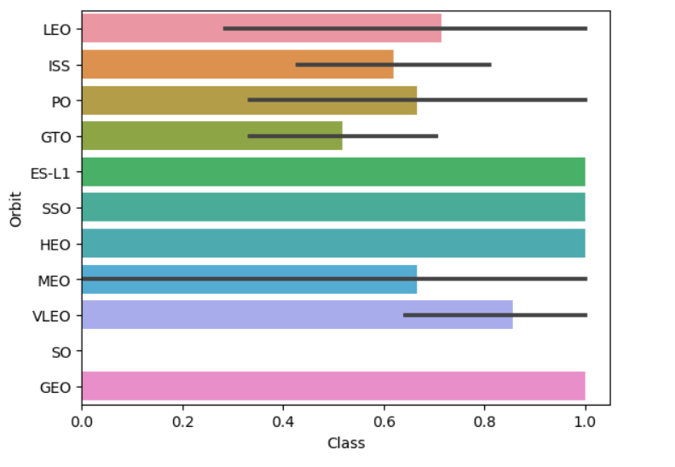
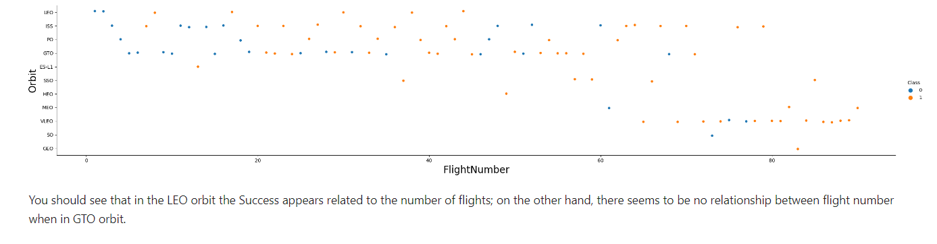
Success Rate vs. Orbit Type
Show a bar chart for the success rate of each orbit type
Show the screenshot of the scatter plot with explanations

Slide 21
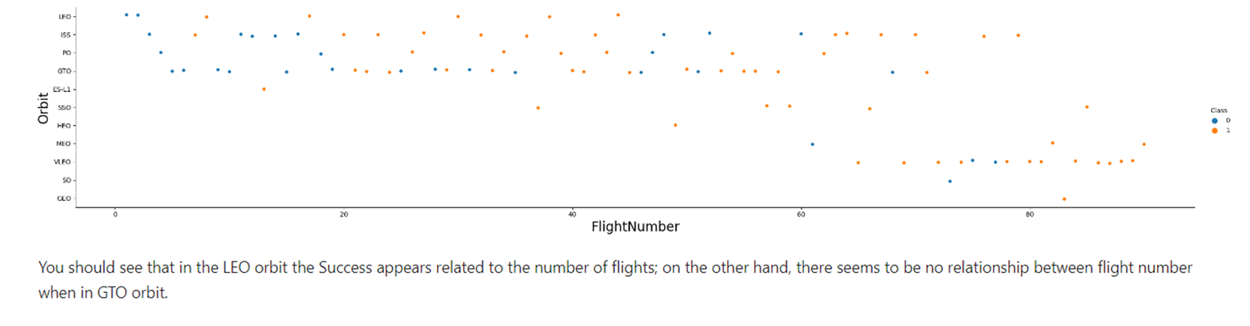
Flight Number vs. Orbit Type
Show a scatter point of Flight number vs. Orbit type
Show the screenshot of the scatter plot with explanations

Slide 22
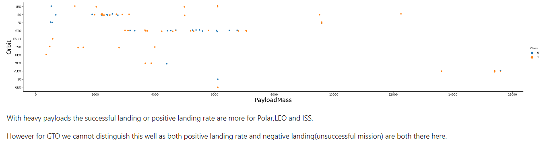
Payload vs. Orbit Type
Show a scatter point of payload vs. orbit type
Show the screenshot of the scatter plot with explanations

Slide 23
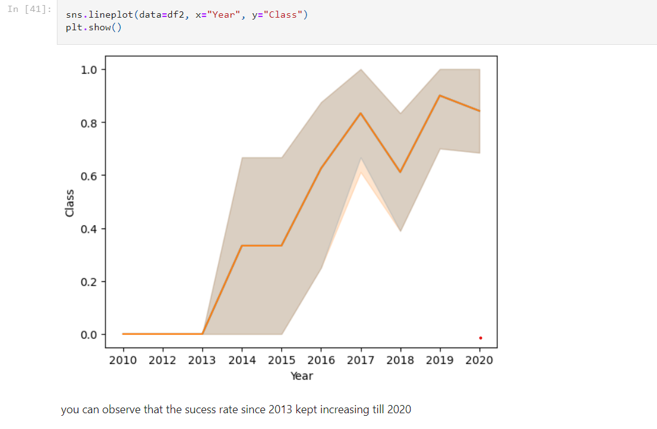
Launch Success Yearly Trend
Show a line chart of yearly average success rate
Show the screenshot of the scatter plot with explanations

Slide 24
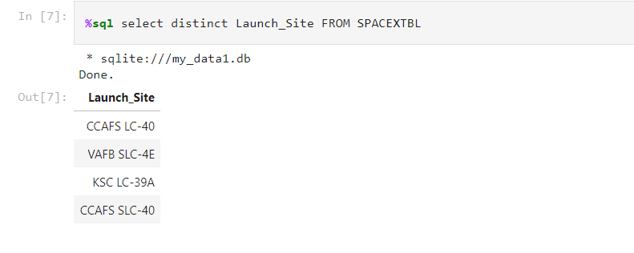
All Launch Site Names
Find the names of the unique launch sites
The command “distinct” avoids repetition of the Launch Sites

Slide 25
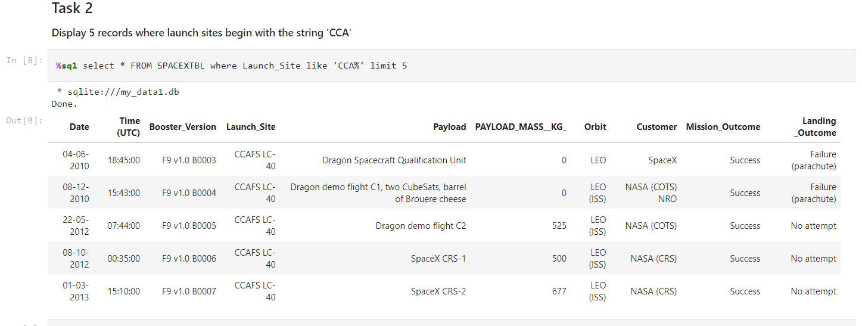
Launch Site Names Begin with 'CCA'
Find 5 records where launch sites begin with `CCA`
% to allow all launch ites starting with cca, and limit 5 to constrain the n records

Slide 26
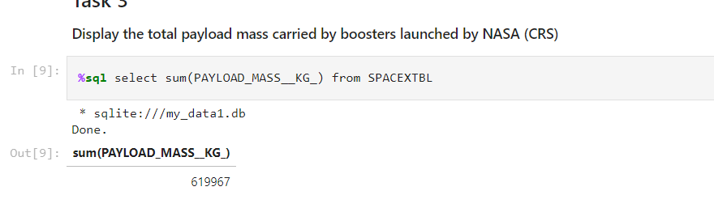
Total Payload Mass
Calculate the total payload carried by boosters from NASA
Sum to obtain the sum of payload

Slide 27
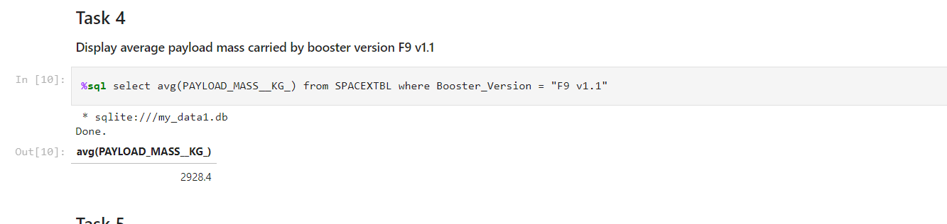
Average Payload Mass by F9 v1.1
Calculate the average payload mass carried by booster version F9 v1.1
Using the avg command to obtain the mean of payload mass carried

Slide 28
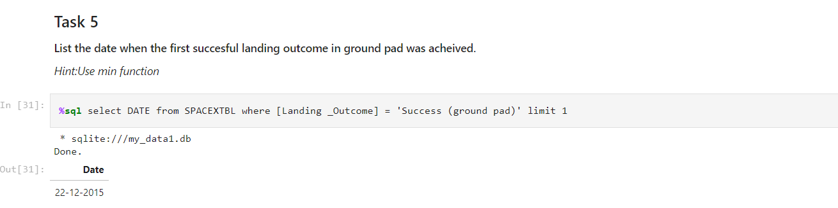
First Successful Ground Landing Date
Find the dates of the first successful landing outcome on ground pad
Using select for the desired term, and getting the first date with limit 1

Slide 29
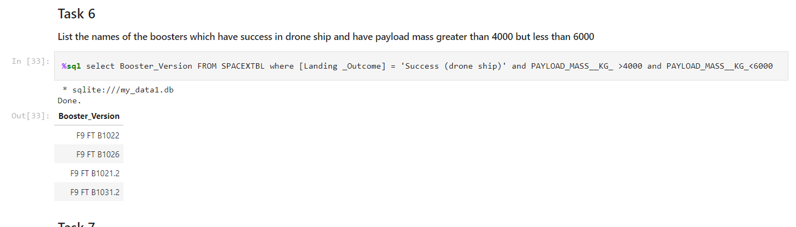
Successful Drone Ship Landing with Payload between 4000 and 6000
List the names of boosters which have successfully landed on drone ship and had payload mass greater than 4000 but less than 6000
Two constraints are used to limit the payload within the limits

Slide 30
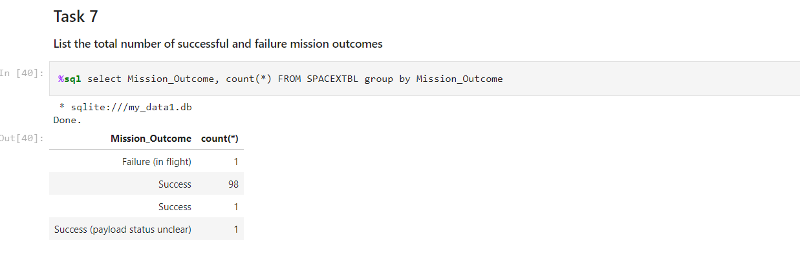
Total Number of Successful and Failure Mission Outcomes
Calculate the total number of successful and failure mission outcomes
Grouping the results by mission outcome

Slide 31
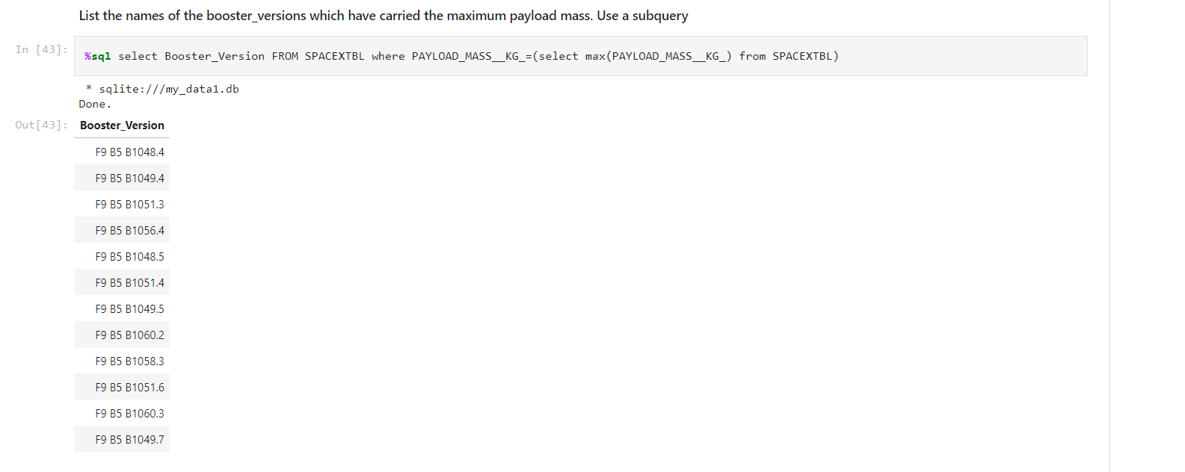
Boosters Carried Maximum Payload
List the names of the booster which have carried the maximum payload mass
Using the max () to constrain the results to maximum payload

Slide 32
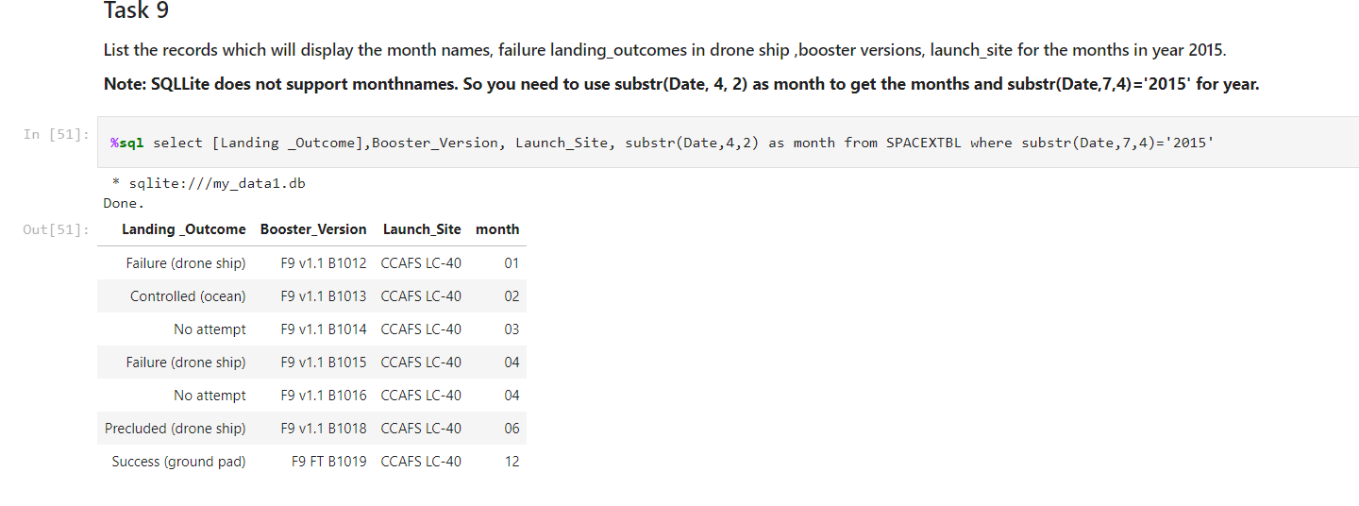
2015 Launch Records
List the failed landing_outcomes in drone ship, their booster versions, and launch site names for in year 2015
Using substr to split date components

Slide 33
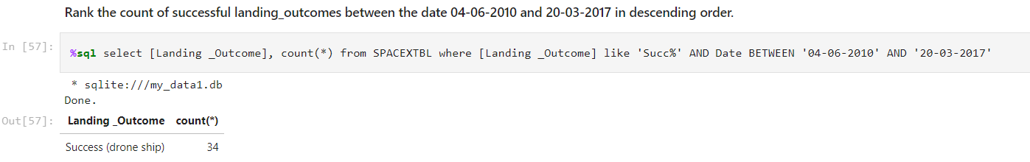
Rank Landing Outcomes Between 2010-06-04 and 2017-03-20
Rank the count of landing outcomes (such as Failure (drone ship) or Success (ground pad)) between the date 2010-06-04 and 2017-03-20, in descending order
Using% as a wildcard, and between to limit the dates to the considered period

Slide 34

Section 3

Slide 35
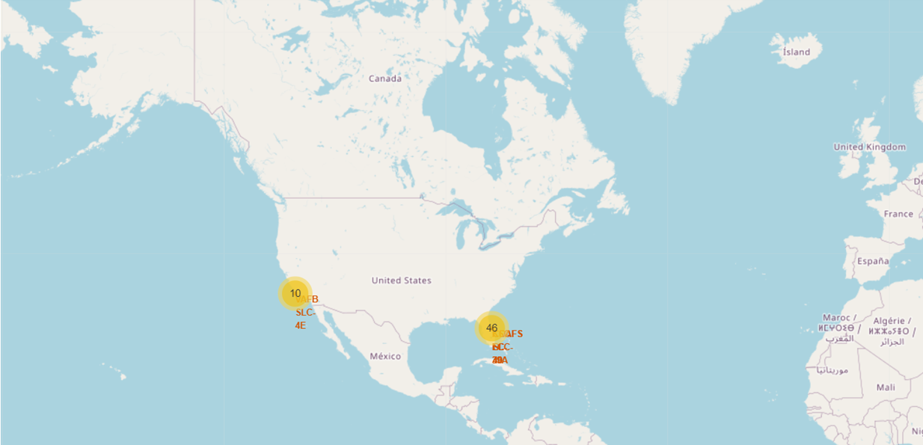
Launch sites - General Location
Southern locations closer to equador – less gravity – easier launch
Near to ocean – prevent crashes on populated areas

Slide 36
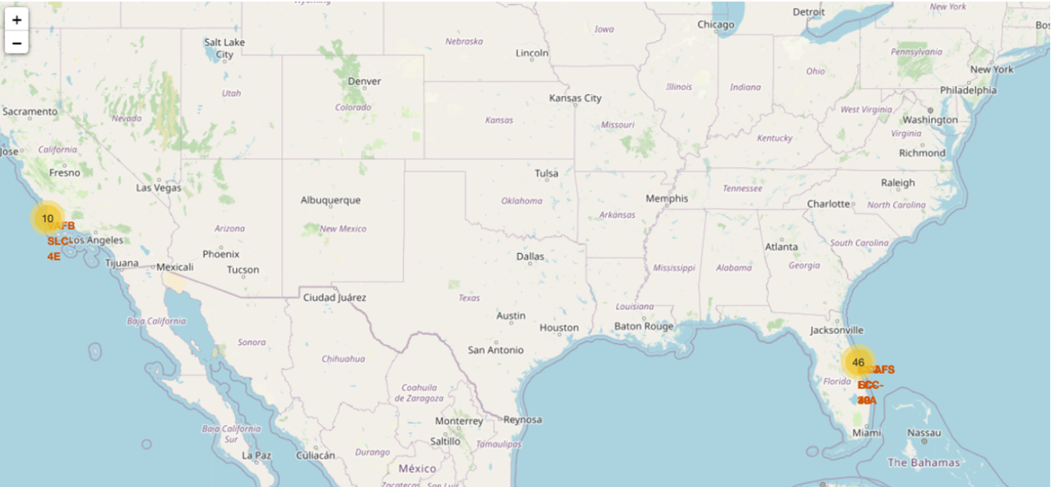
Records geographic representation
Grouped marks representing the number of records

Slide 37
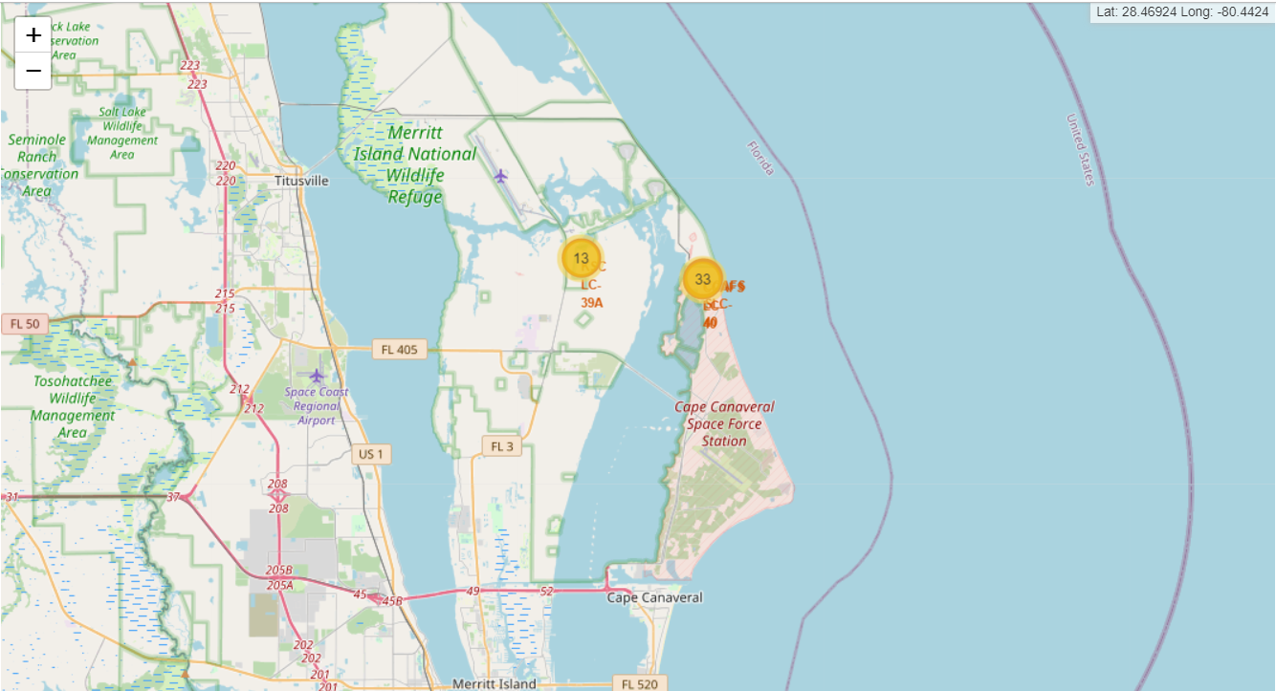
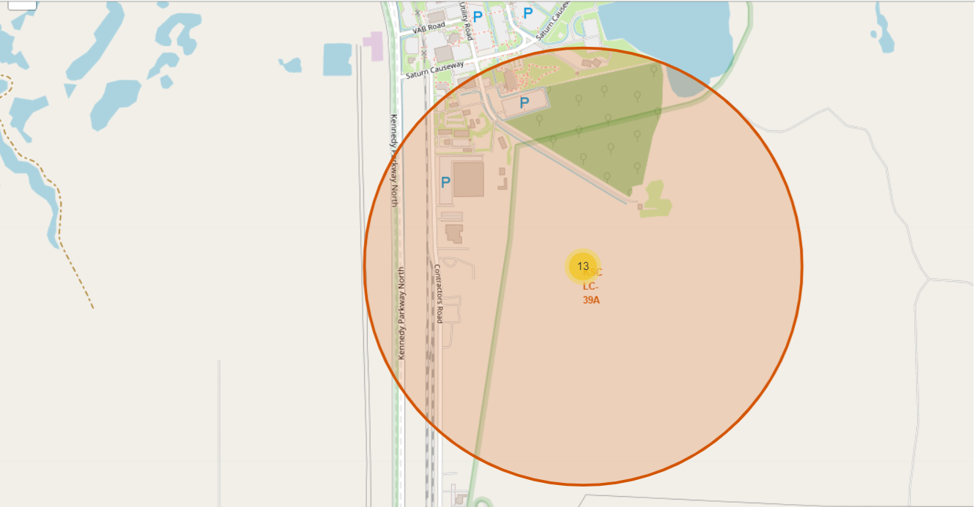
Geographic Disposition of nearby launch sites
Low density populated areas

Slide 38

Section 4

Slide 39
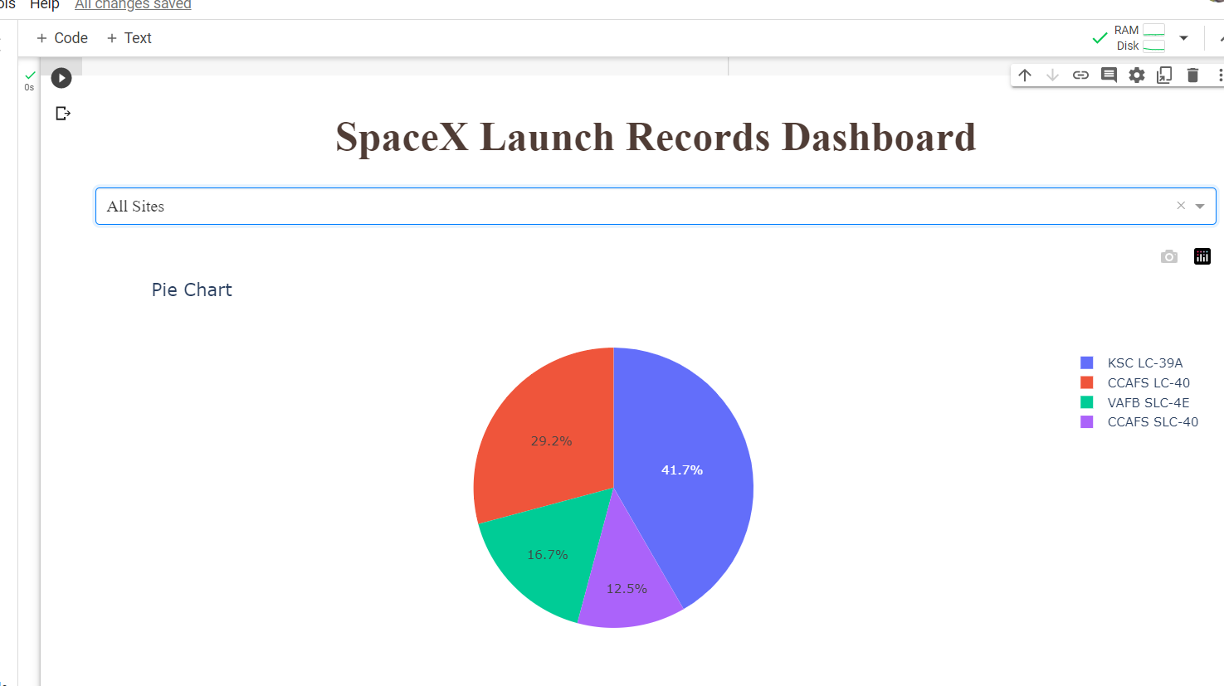
Launch success count for all sites
class 1 - insucess
ksc +
ccafs slc 40 -

Slide 40
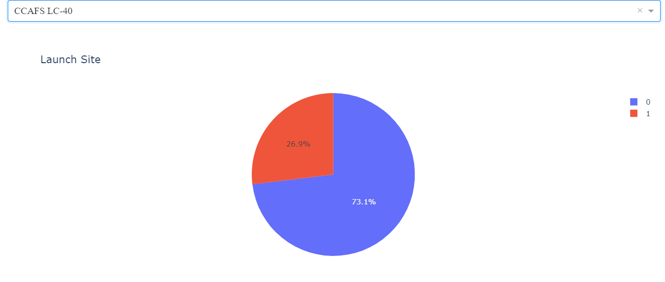
Highest launch success ratio

Slide 41
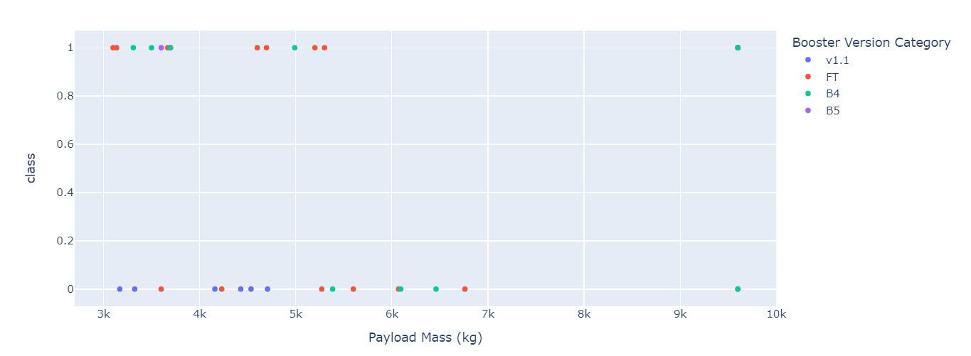
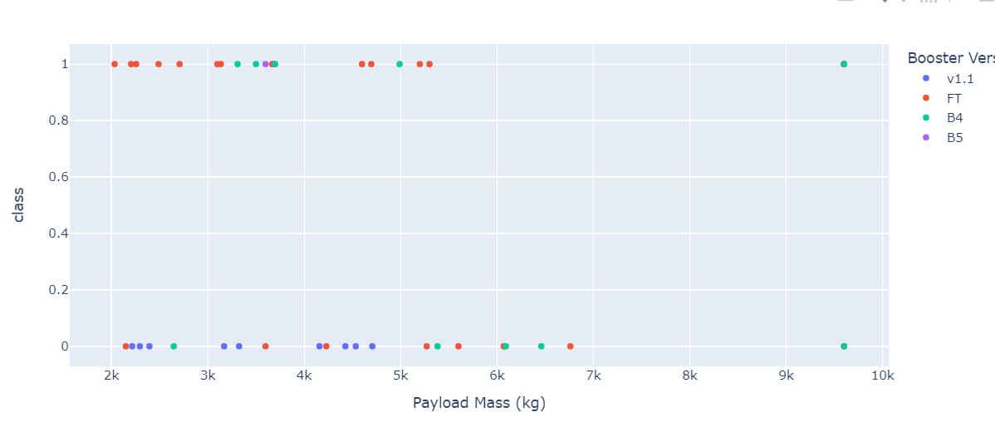
Payload X class
Possibility to analyse specific ranges

Slide 42

Section 5

Slide 43
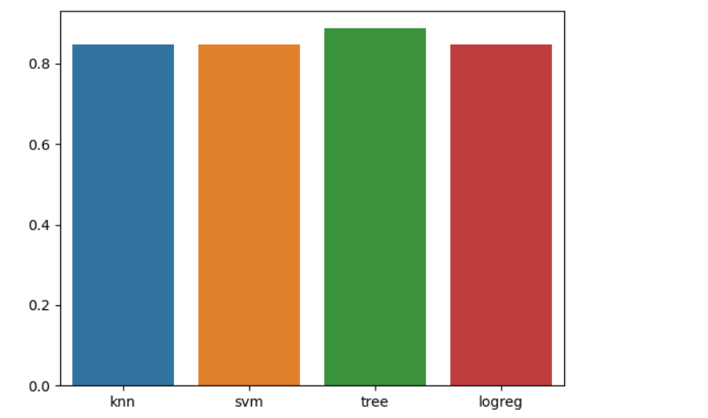
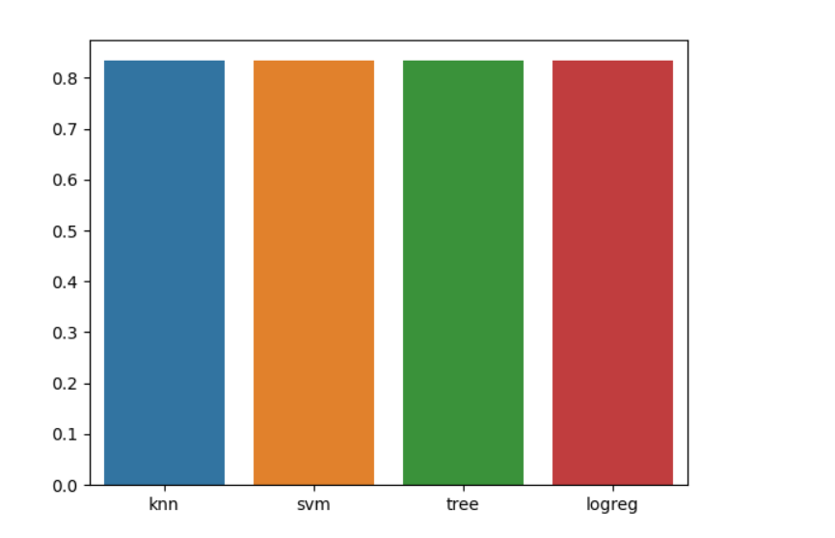
Classification Accuracy
Train – tree seems better
Test – all models equivalent
Since all have the same performance on test, tree have the best train accuracy

Slide 44
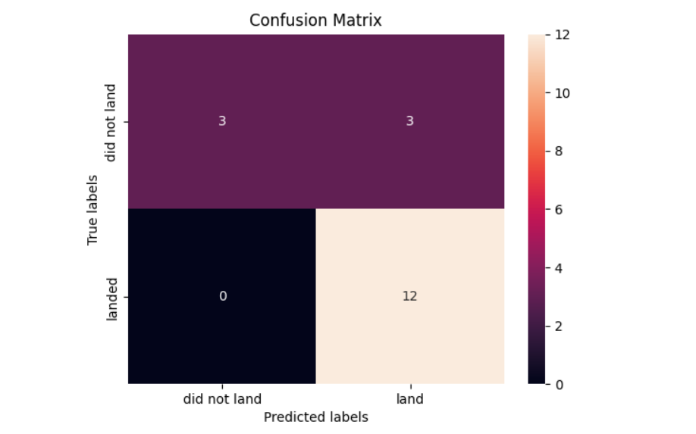
Confusion Matrix
There are only 18 samples to test 3 TN, 12 TP and 3 FP (0 FN).

Slide 45
Conclusions
flight number increases, the first stage is more likely to land successfully.
more massive the payload, the less likely the first stage will return
Relation orbit X number of flight is not appearing in all orbits
Yearly trend of success
Machine Learning Models with close accuracy on test set
Prediction model reaching approximately 0.83 on test set
Contingency table - no False Negatives on the model

Slide 46
Appendix
It was useful to use Google Colab for some executions
Specially in dash, the use of inline execution allowed an easier debug

Slide 47


